Slide 1



BANKER'S ALGORITHM (FOR DEADLOCK AVOIDANCE)
S UDHAYA SANKARI
(BL.EN.U4CSE23150)
GEETHIKA YARABOLU
(BL.EN.U4CSE23123)
REDDI TEJEESH SAI
(BL.EN.U4CSE23147)
VISHWA REDDY
(BL.EN.U4CSE2314)
Notes:
asdf

Slide 2


INDEX
BACKGROUND STUDY
DESIGN
DEFINATION
METHADOLOGY
ALGORITHM
SIMULATION : TINKERCAD
SIMULATION : MATPLOTLIB
SIMULATION : TKINTER
COMPARISON OVERVIEW
CONCLUSION

Slide 3
BACKGROUND STUDY
Deadlock occurs when processes wait indefinitely for resources.
Banker’s Algorithm (by Edsger Dijkstra) ensures safe resource allocation to avoid deadlocks.
It uses a trial allocation and safe state checking approach before granting resources.

Slide 4
DESIGN
Uses four main data structures.
Calculate Need = Max - Allocation.
Simulate Banker’s Algorithm in different styles :
request handling.
Safe sequence generation.
Visual Representation
Data saving for repeat simulations.

Slide 5
DEFINATION
The bankers algorithm is an resource allocation and a deadlock avoidance strategy that ensures remains stays in a safe state by :
Finding a safe sequence of process execution
Granting or denying resources based on safety check

Slide 6
METHADOLOGY
Input Matrices:
Allocation, Max, Available
Need Calculation:
Need[i][j] = Max[i][j] – Allocation[i][j]
Safe Sequence Check:
Find if a sequence exists where all processes can complete safely.
Dynamic Request Handling (only for TinkerCAD):
Check if a new resource request can be granted without entering unsafe state.
Dataset Management (only for Tkinter):
Allow saving/loading/resetting inputs for future runs.

Slide 7
Step 1: Input System Information
Allocation Matrix
Maximum Demand Matrix
Available Resources Vector
Step 2: Compute the Need Matrix
For each process and resource:
Need[i][j] = Max[i][j] - Allocation[i][j]
Step 3: Initialize Variables
Set Work = Available (copy of available resources)
Set Finish[i] = False for all processes
Step 4: Find an Executable Process
Search for a process i such that:
Finish[i] == False, and
For every resource j, Need[i][j] ≤ Work[j]
ALGORITHM

Slide 8
Step 5: Simulate Resource Allocation
If such a process is found:
Allocate resources: Work = Work + Allocation[i]
Mark process as finished: Finish[i] = True
Add process i to the Safe Sequence list
Step 6: Repeat
Continue Steps 4–5 until:
All processes are marked finished (Safe State), or
No process can be executed (Unsafe State)
Step 7: Result
If all Finish[i] == True:
➔ A Safe Sequence exists; the system is in a Safe State.
Else:
➔ No safe sequence; the system is in an Unsafe State.
ALGORITHM

Slide 9
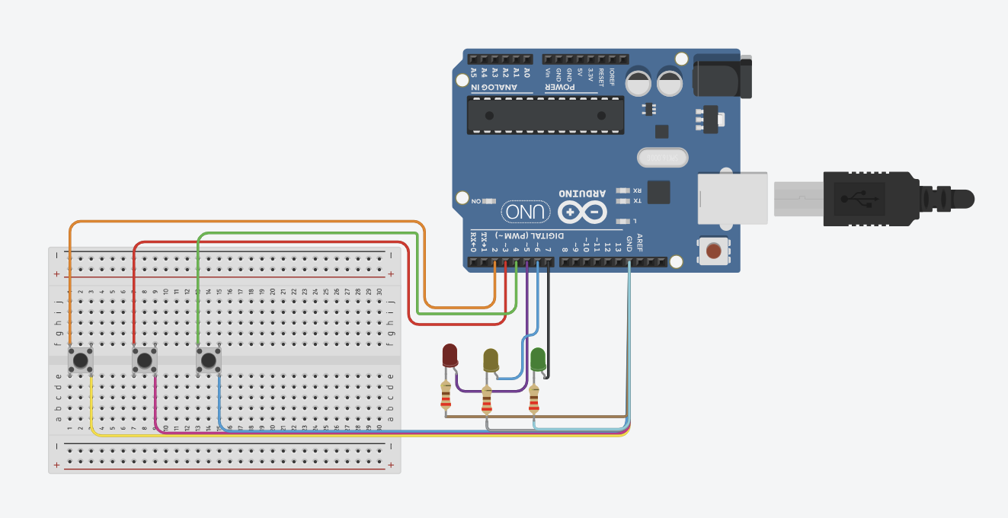
SIMULATION USING TINKERCAD
Highlights:
Safe sequence is printed based on initial matrices.
Static Input and Dynamic resource request acceptance/rejection is supported during runtime.
After each request, system checks whether it remains in a safe state.
Immediate feedback: "Request Granted" or "Request Denied".
Efficiency:
Closely resembles real-world OS behavior.
Enables simulation of live resource demands and decision-making.

Slide 10
SIMULATION LINK
https://www.tinkercad.com/things/fZ5gyt74xhl-os-proj/editel?returnTo=https%3A%2F%2Fwww.tinkercad.com%2Fdashboard
https://www.tinkercad.com/things/fZ5gyt74xhl-os-proj/editel?returnTo=https%3A%2F%2Fwww.tinkercad.com%2Fdashboard

Slide 11
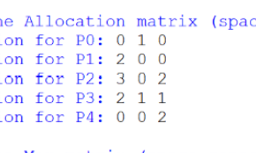
SIMULATION USING MATPLOTLIB
(PYTHON)
Highlights :
Dynamic matrices are defined at the start.
Only one-time safe sequence calculation and printing is performed.
No facility to handle dynamic requests after initial allocation.
Efficiency:
Quick and simple simulation for understanding safe state computation.
Suitable for theoretical illustration.

Slide 12
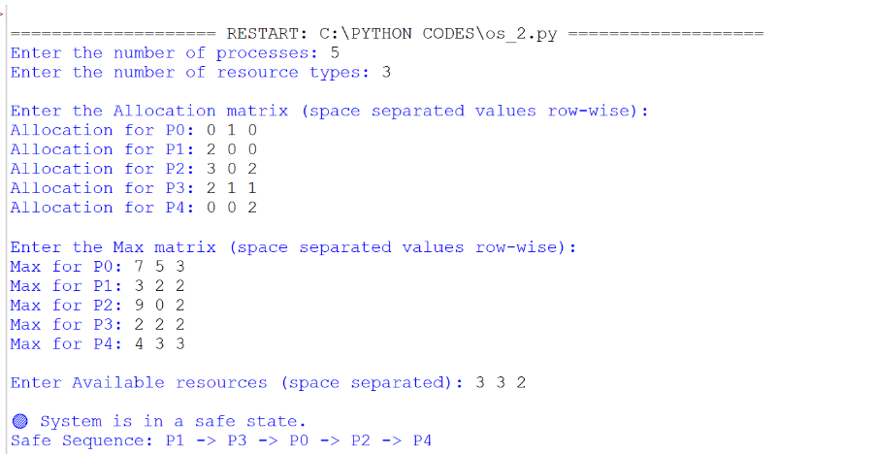

Slide 13
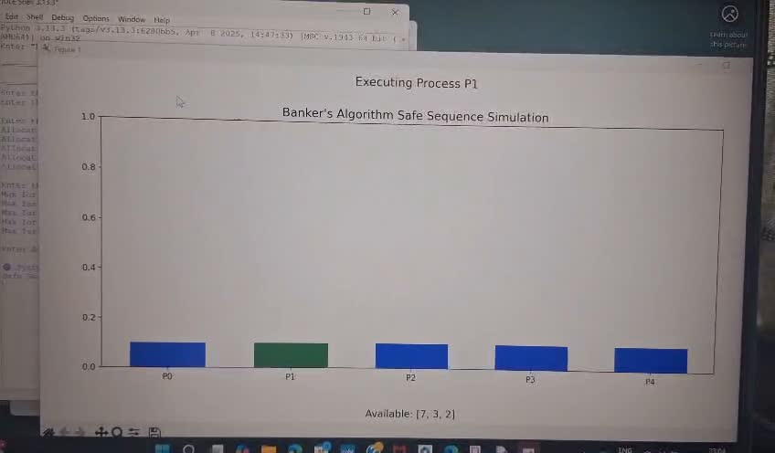

Slide 14
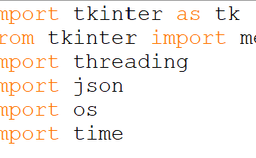
SIMULATION USING TKINTER (PYTHON GUI)
Highlights :
User can input matrices dynamically via GUI fields.
Safe sequence is calculated and printed based on user input.
Datasets can be saved/loaded/reset for multiple experiments.
Supports easy replay of previous cases for study.
Efficiency:
Interactive GUI allows hands-on understanding of Banker's Algorithm.
Dataset persistence improves repeatability of experiments.

Slide 15


Slide 16
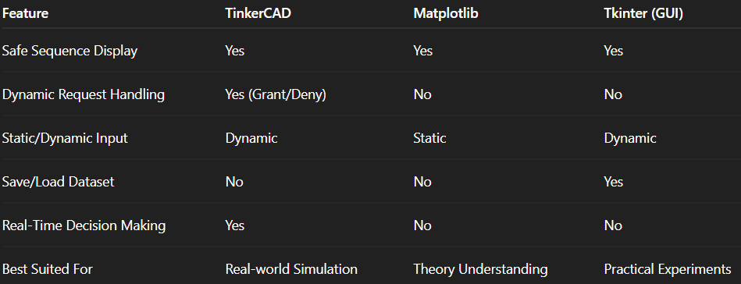
EXPLANATION AND COMPARISON OVERVIEW
Static
Dynamic
Dynamic

Slide 17


CONCLUSION
All three simulators correctly implement Banker’s Algorithm by checking for safe sequences.
TinkerCAD adds real-world behavior by allowing dynamic resource request management
Matplotlib provides a clean, minimal illustration of safe sequence logic.
Tkinter adds dataset persistence, improving repeatability and experimentation.
Together, these simulations provide a comprehensive understanding of deadlock avoidance mechanisms.

Slide 18


THANK YOU

